Slide 1
Abstract and learning objectives
Abstract
This whiteboard design session will guide us through designing an end-to-end solution for e-commerce that is based on Azure App Services, Azure Active Directory, and Azure Serverless. We must ensure the solution is PCI-compliant, and that appropriate security measures are put into place for both on-premises and public access scenarios.
Learning objectives
Deploying and configuring Azure Web Apps
Configuring web apps for authentication with Azure AD and Azure AD B2C
Instrumenting and load-testing applications with App Insights
Automating back-end services using Azure Functions and Logic Apps
Notes:
This is an introduction to the Cloud Workshop at a high level. Later we’ll get into customer objections, requirements, etc… but we want to ground the participants on the business outcomes we’re going after for the day.

Slide 2
Welcome! Integration with Azure
<proctor name> - <proctor title>

Slide 3
Welcome to Country
We acknowledge the traditional custodians of the land and their continuing connection to our community. We pay respect to them, their culture and to their elders past and present.

Slide 4
Wi-Fi Access
Wi-Fi SSID:
MSFTGUEST
Event Attendee Code:
msevent800en

Slide 5
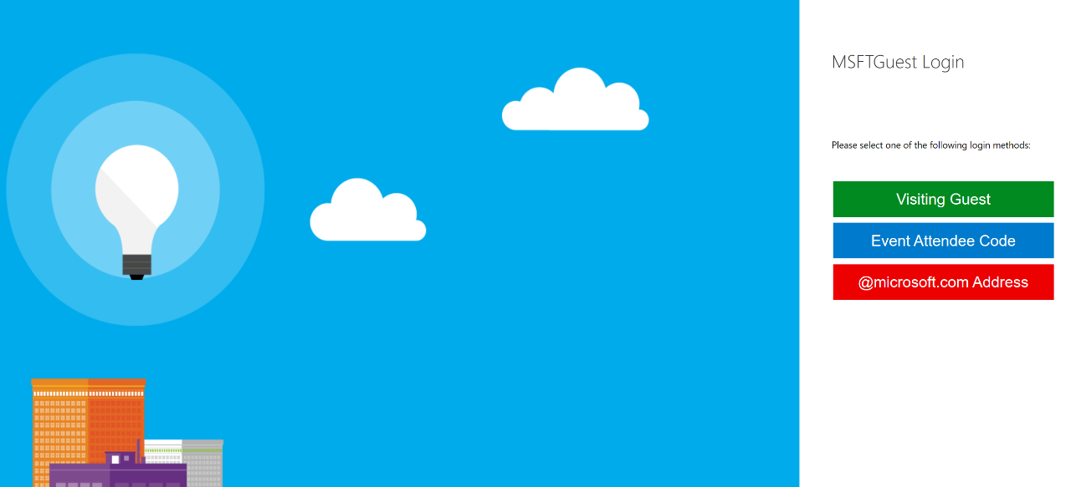
Setting up Wi-Fi Access
Connect to MSFTGUEST Wi-Fi network
A browser window should pop-up with further instructions. If the window does not appear, open a browser window and navigate to the following URL: https://msftguestap.partners.extranet.microsoft.com/guest/msfteventlogin.php?browser=1
Click on Event Attendee Code

Slide 6
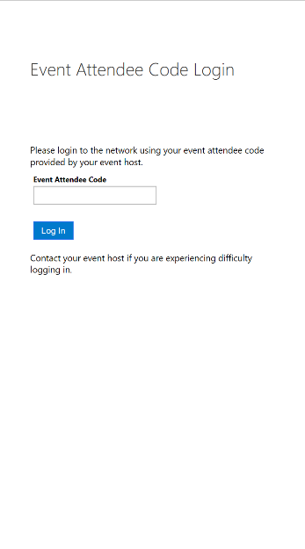
Setting up Wi-Fi Access
Enter the Event Attendee Code
Event Attendee Code:
msevent800en

Slide 7
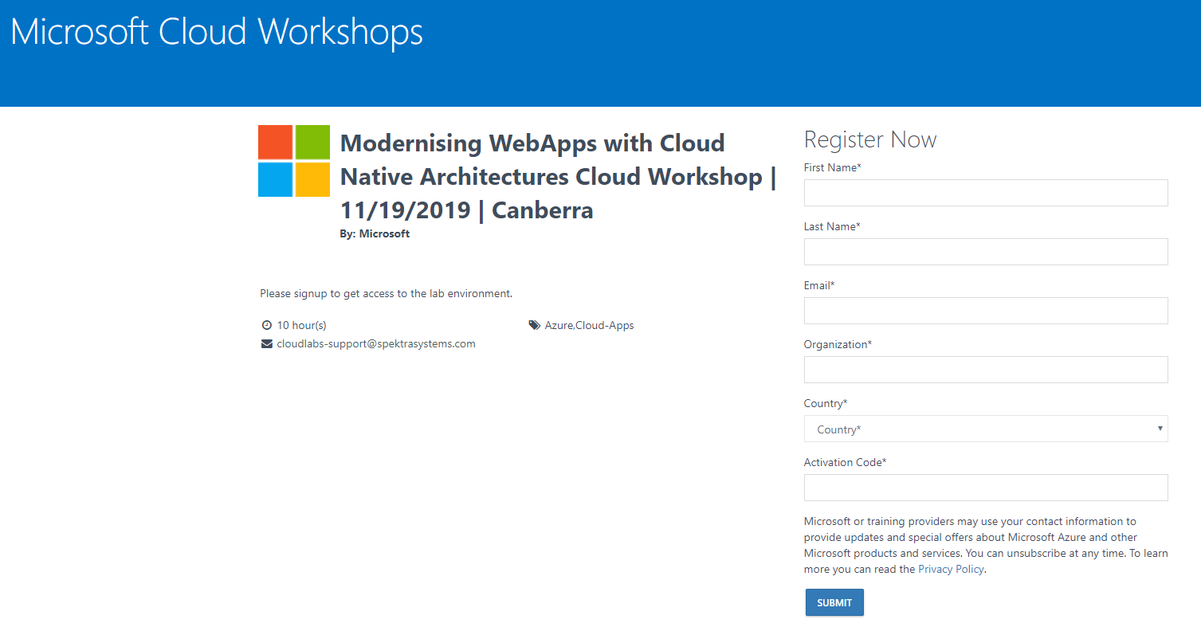
Lab Access
Lab Link:
http://bit.ly/2PCgAHC
Activation Code:
ACTIVATE4666

Slide 8
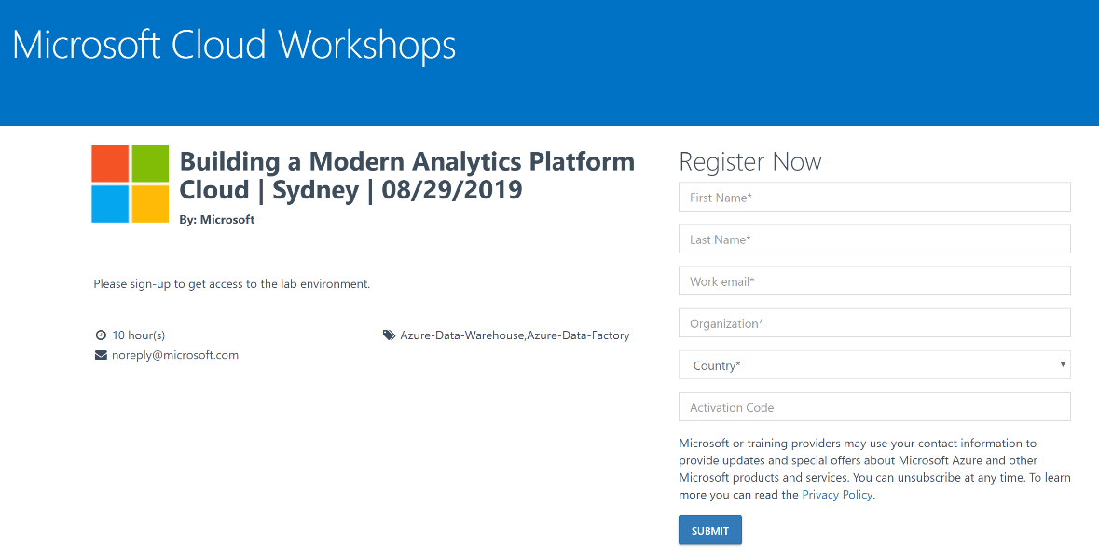
Lab Access
Open a browser window and navigate to the environment sign-up page on the link provided
Enter your details and type in the Activation Code provided
Click Submit
Environment Sign-Up Link:
http://bit.ly/2PCgAHC
Activation Code:
ACTIVATE4666

Slide 9
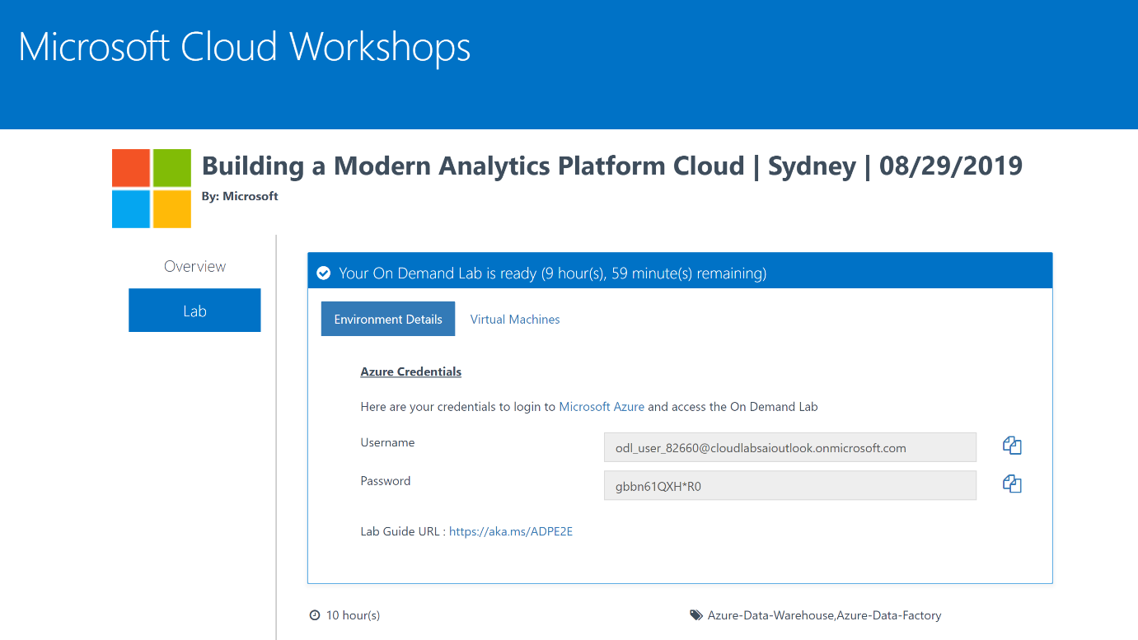
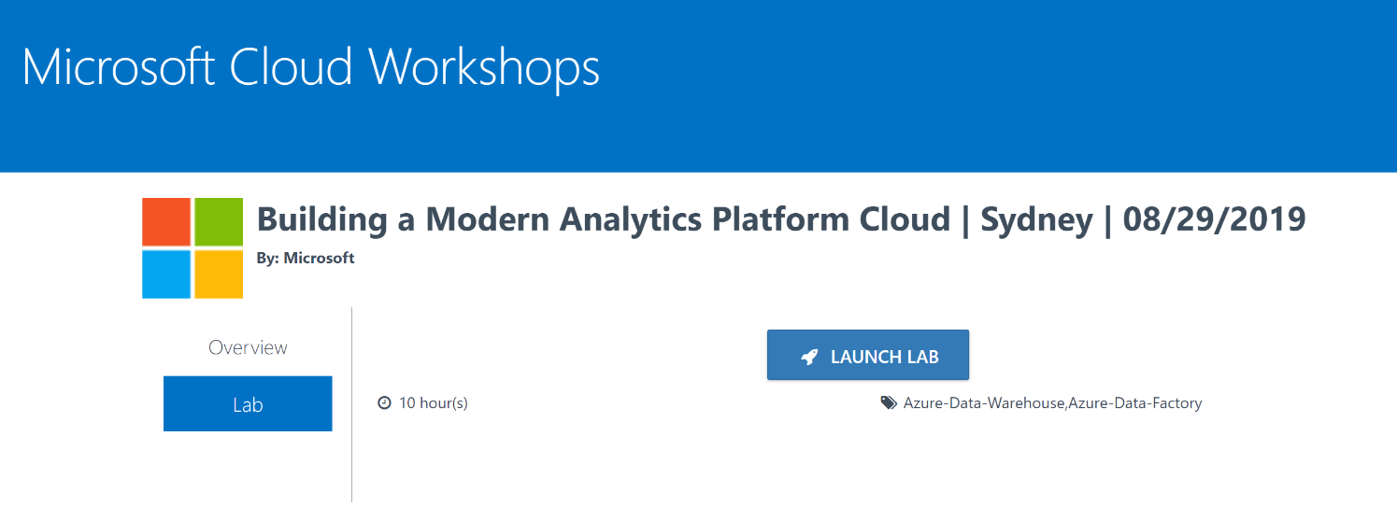
Lab Access
Click LAUNCH LAB
The Environment Details window will appear. Use the Username and Password in this window to access the Azure Portal.
Azure Portal:
https://portal.azure.com/
Lab Guide:
https://aka.ms/MCWMCA

Slide 10
Event Housekeeping
Please turn your phones to silent
Bathrooms are located down the hall
Food is provided for Morning Tea, Lunch, Afternoon Tea (Dietary requirements have been catered for, please respect the needs of these people)
Please be mindful that you are in an office environment and respect those who are working nearby
Please do not enter any meeting rooms other than the event room

Slide 11
Agenda
 | Duration | Start Time | End Time
Workshop Overview | 15 | 9:00 am | 9:15 am
Integration theory and services | 45 | 9:15 am | 10:00 am
Reviewing the case study | 15 | 10:00 am | 10:15 am
Morning Tea Break | 15 | 10:15 am | 10:30 am
Solution design | 60 | 10:30 am | 11:30 am
Preferred Solution walk through and debrief | 30 | 12:00 am | 12:30 am
Lunch | 30 | 12:30 pm | 1:00 pm
Case study design – asset register | 30 | 1:00 pm | 1:30 pm
Case study design – Logical diagram | 60 | 1:15 pm | 2:15 pm
Afternoon Tea Break | 15 | 2:15 pm | 2:30 pm
Case study design – technical architecture | 70 | 2:30 pm | 3:45 pm
Summarize etc. | 15 | 3:45 pm | 4:00 pm

Slide 12
Agenda
 | Start Time
Workshop Overview | 9:00 am
Intro content and workshop discussion
Morning Tea Break | 10:15 am
Workshop cont.
Lunch | 12:30 pm
Case study
Afternoon Tea Break | 2:15 pm
Case study cont.
Summarize etc.
Finish! | 4:00 pm

Slide 13

Abstract and learning objectives
In this whiteboard design session, you work with a group to design a solution for integrating different services by leveraging Azure solutions. As part of the modernization effort, application enhancements are added using a mix of cloud and on-prem services.
At the end of this whiteboard design session, your ability to design an integration strategy for organizations looking to modernize on the cloud will be improved.

Slide 14
Before we begin…
What is ‘integration’?
What tools are available?

Slide 15
Integration…
Solves a set of common problems:
Stuff needs to be connected
The internet isn’t reliable
Applications are different in what they ask/tell

Slide 16
Integration contains…
Entities:
Messages
Events
“Data”
Entity “handlers”:
Connectors
Routers
‘Bus’
ETL
APIs
Contracts
Etc.
Entities:
Messages
Events
“Data”
and...

Slide 17
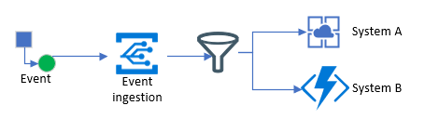
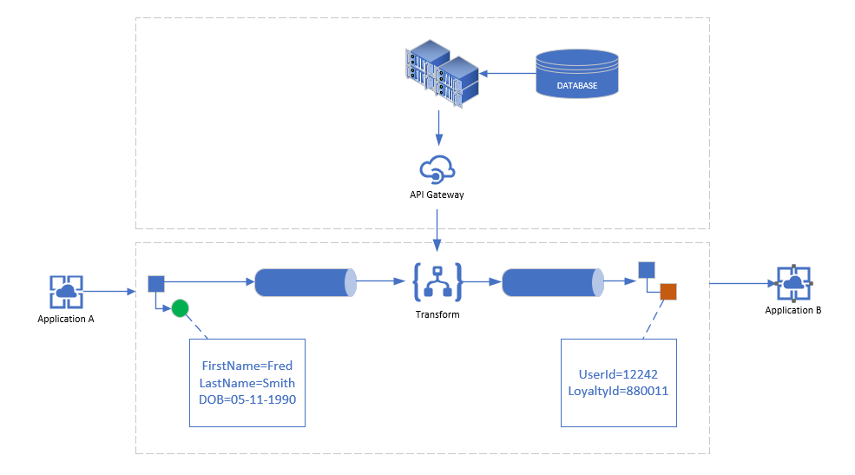
Integration is…a series of patterns
Patterns are modular, discreet solutions which are composed of ‘entities’ and ‘entity handlers’ and fit together, like Lego

Slide 18
Integration is…a series of patterns
What are some common patterns you can think of?
https://aka.ms/workshop-integration-patterns

Slide 19
What about Azure Integration Services?...
https://azure.microsoft.com/en-au/product-categories/integration/
https://aka.ms/integration-white-paper

Slide 20
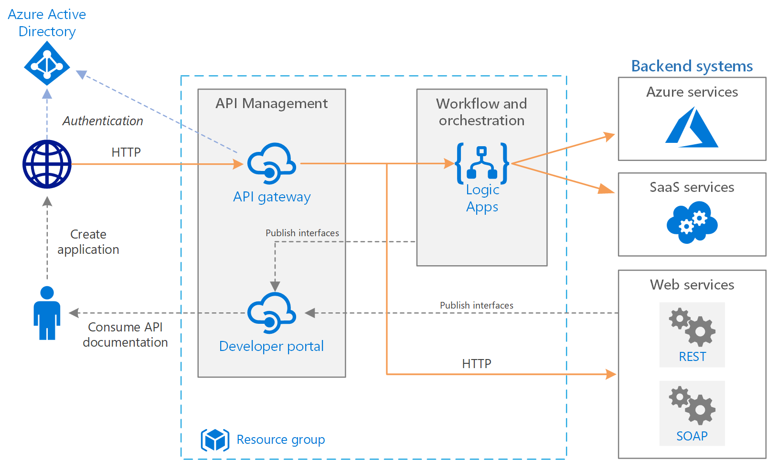
Some reference architectures
https://docs.microsoft.com/en-us/azure/architecture/reference-architectures/enterprise-integration/basic-enterprise-integration

Slide 21
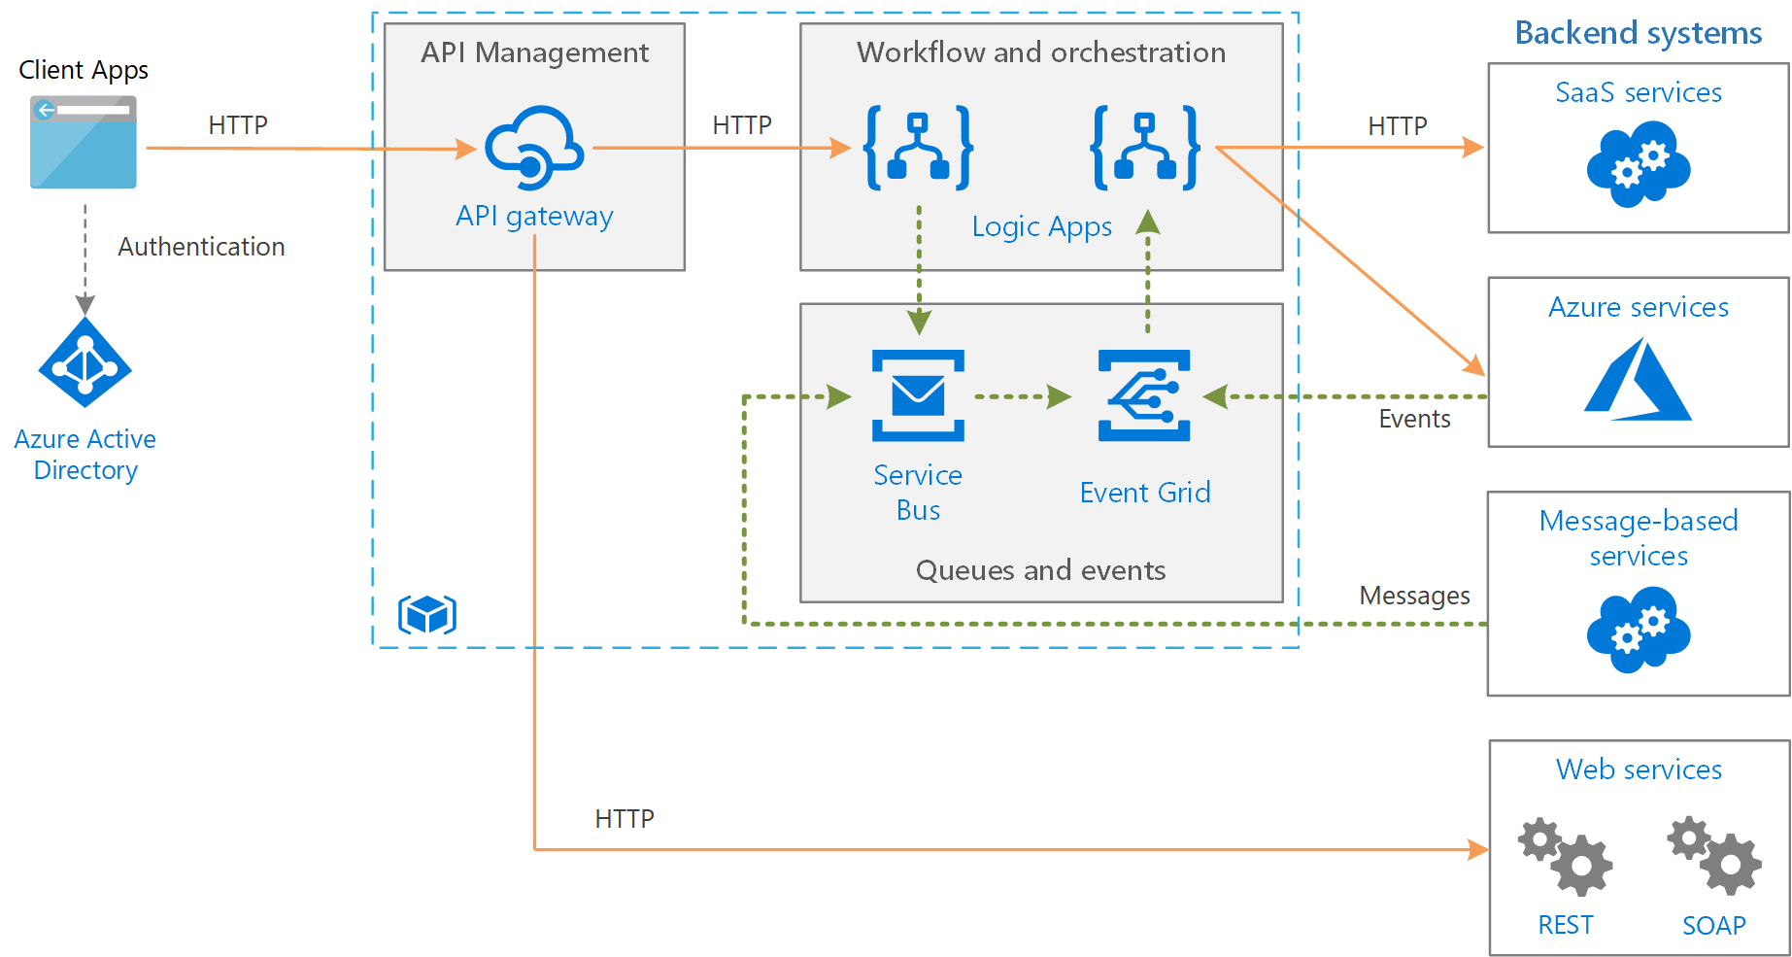
Some reference architectures
https://docs.microsoft.com/en-us/azure/architecture/reference-architectures/enterprise-integration/queues-events

Slide 22

Customer situation
Fluffy Ducks. Co large multi-national organization, which sells plush ducks.
Technology has grown over time due to acquisitions etc.
Have run into several issues with current integration design, and it looking to modernize

Slide 23
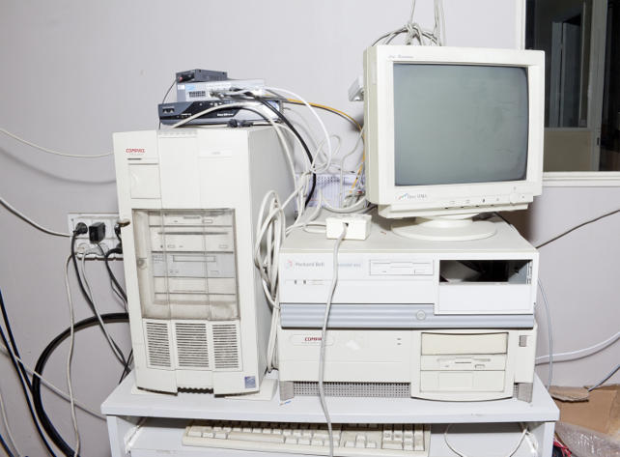
Customer situation
Looking to replace BizTalk, and looking to replace on-prem EOL hardware
Current integration solution doesn’t scale
Integrates with dynamics-365 and a 3rd-party provider
Business has appetite for innovation and redesign of current architecture

Slide 24

Customer needs
Move infrastructure and BizTalk to iPaaS solutions
Ensure local developers aren’t running SSIS packages locally
Migrate most payroll functions to PaaS
Provide a better experience when working with partner organizations (onboarding, data and API exchange, documentation)

Slide 25


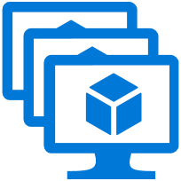
Customer objections
How can the system automatically sync and trigger off of events happening?
Can solution provide a seamless partner integration experience for onboarding etc?
Can we secure the platform with an identity platform, such as Azure AD?

Slide 26
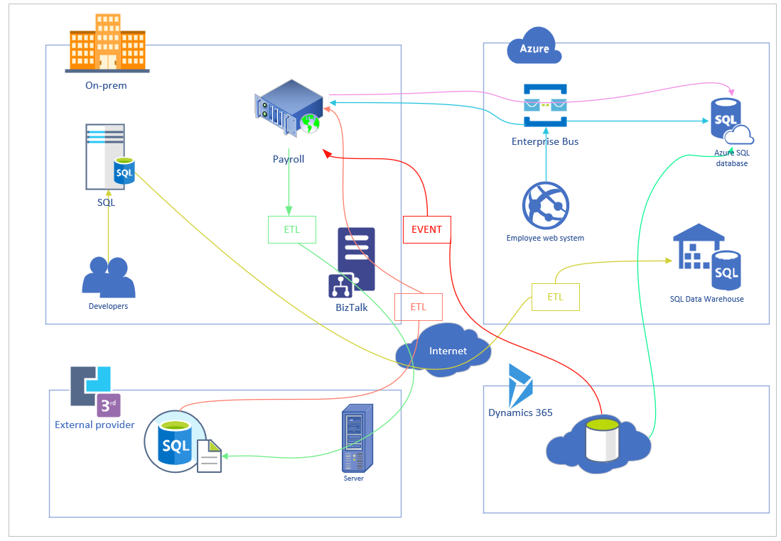
High-level requirements
https://aka.ms/workshop-integration-case-study

Slide 27
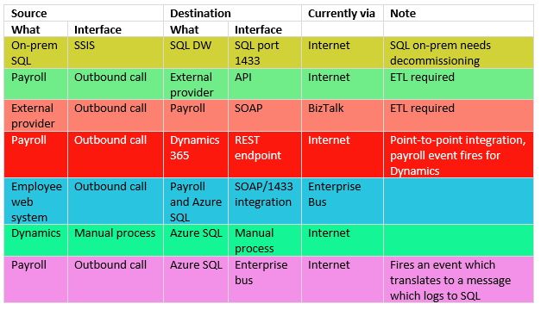
High-level requirements cont.
https://aka.ms/workshop-integration-case-study

Slide 28
Step 1: Review the customer case study
Go to:
https://aka.ms/workshop-integration-case-study
Outcome
Analyze your customer needs.
Timeframe
15 mins

Slide 29
Step 2: Design the solution
Outcome
Design a solution and prepare to present the solution to the target customer audience in a 15-minute chalk-talk format.
Timeframe
~1.5 hours total
https://aka.ms/workshop-integration-case-study

Slide 30
Step 3: Present the solution
Outcome
Present a solution to the target customer in a 15-minute chalk-talk format
Timeframe
30 minutes (15 minutes for each team to present and receive feedback)
Directions
One table is the Microsoft team and the other table is the customer.
The Microsoft team presents their proposed solution to the customer.
The customer asks questions about the proposed solution.
The customer team gives feedback to the Microsoft team.
https://aka.ms/workshop-integration-case-study

Slide 31
Wrap-up
Outcome
Identify the preferred solution for the case study.
Identify solutions designed by other teams.
Timeframe
15 minutes

Slide 32
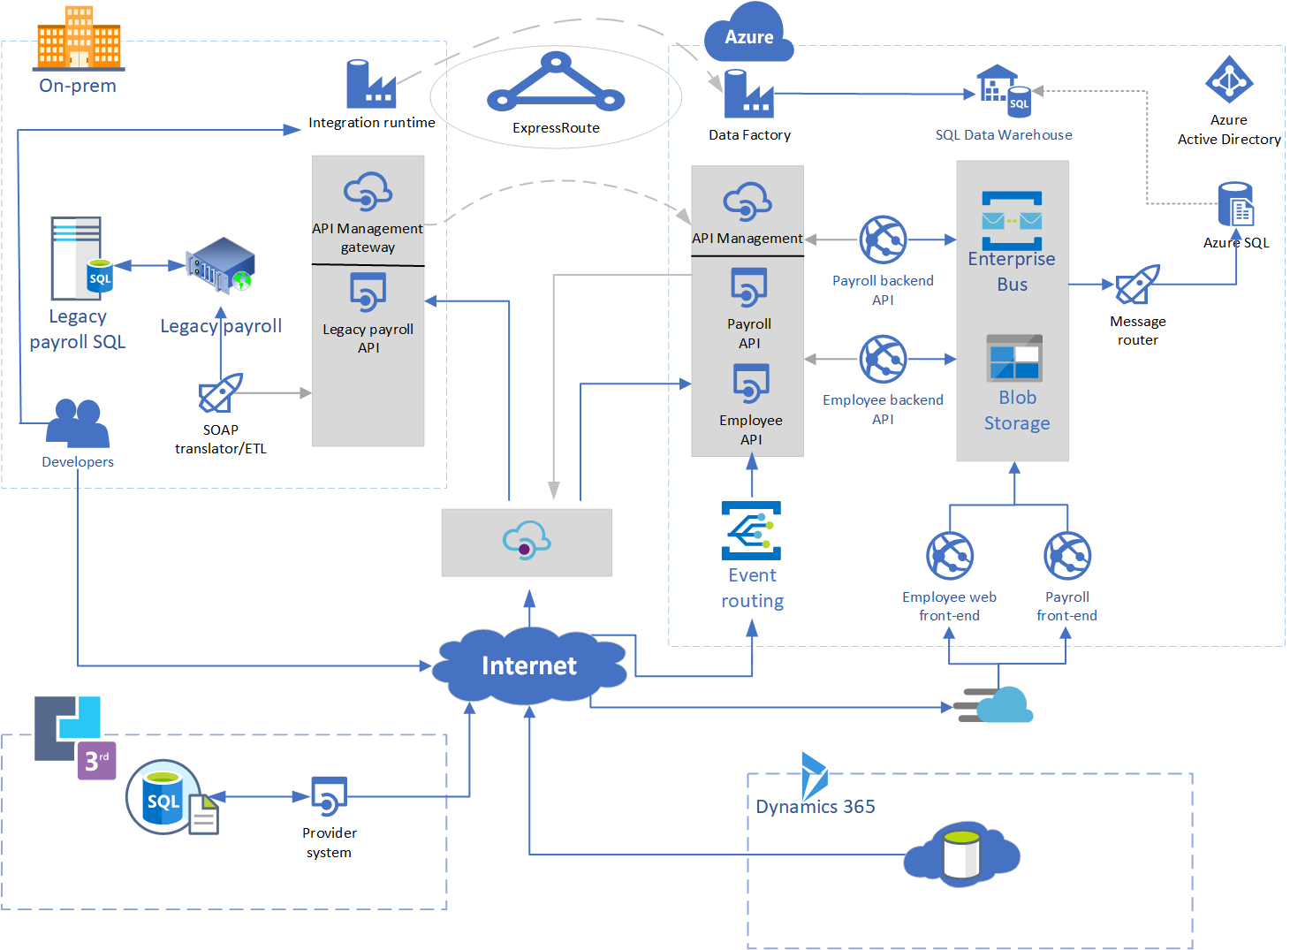
One solution
ABoatwright@bunnings.com.au

Slide 33
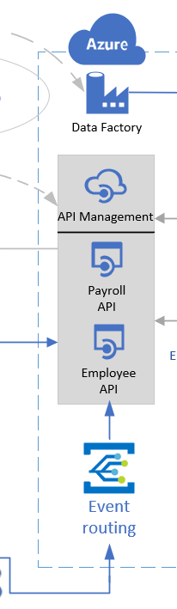
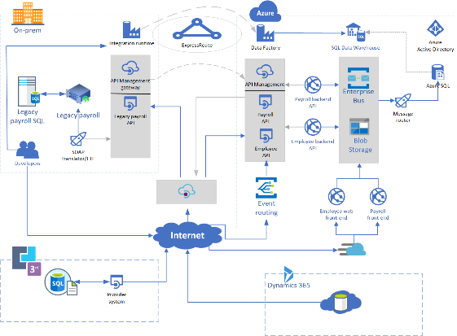
One solution cont.

Slide 34
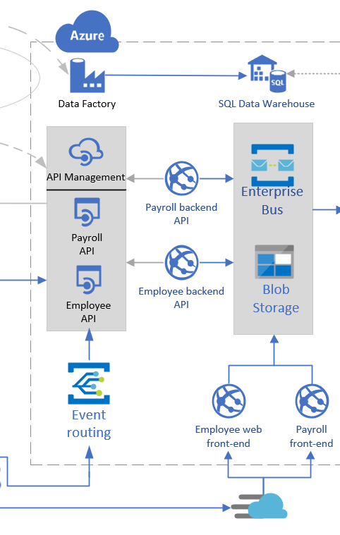
One solution cont.

Slide 35
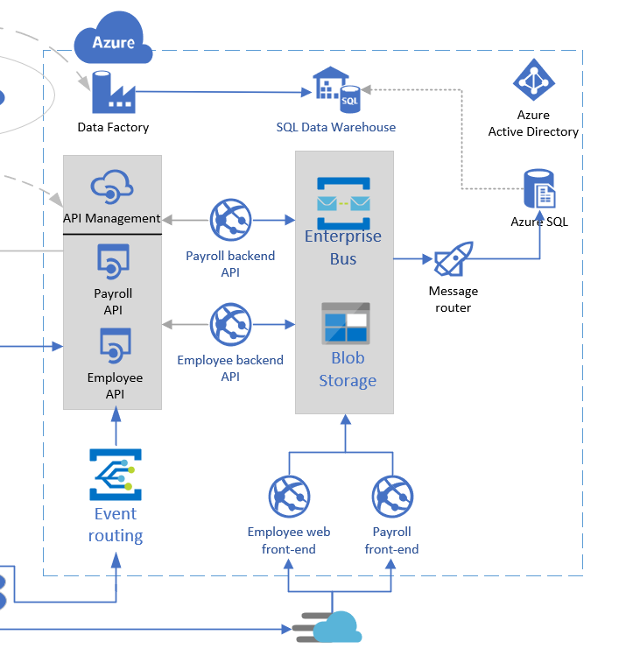
One solution cont.

Slide 36
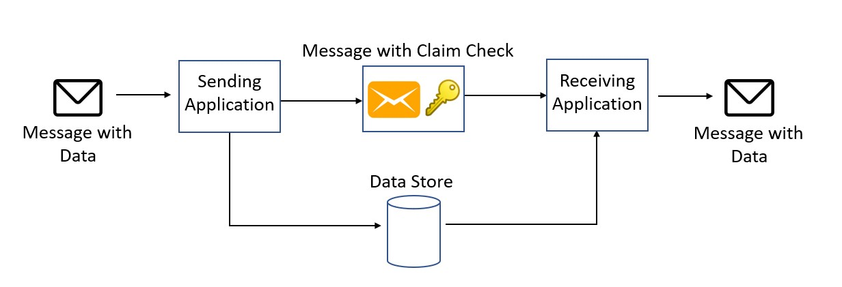
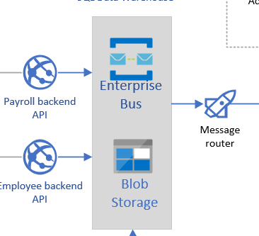
Employee/payroll pattern implemented – claim check

Slide 37
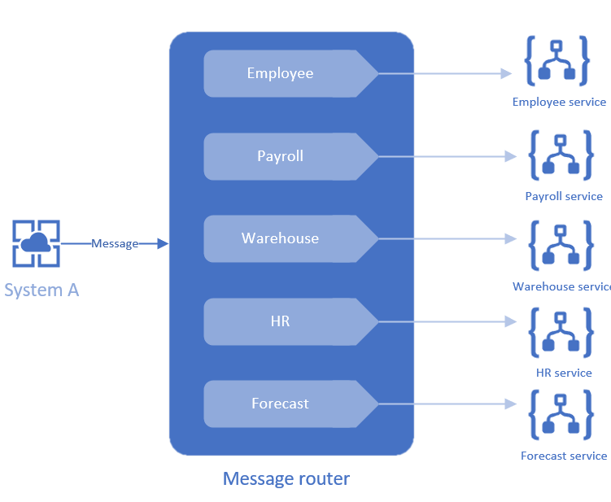
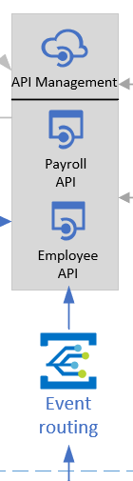
Employee/payroll pattern implemented – message/event router

Slide 38

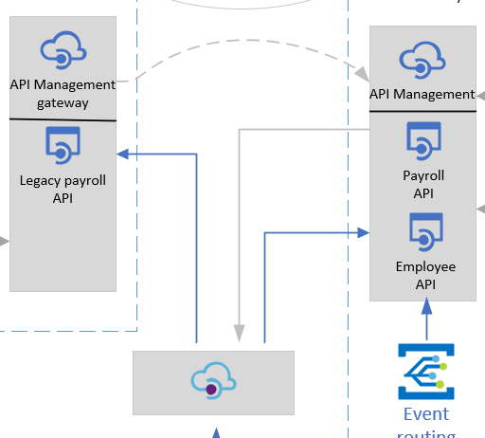
One solution cont.

Slide 39
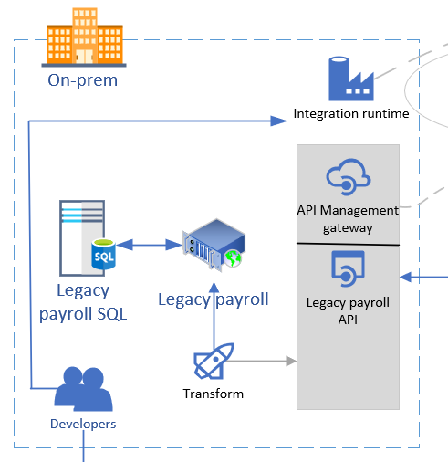
One solution cont.

Slide 40
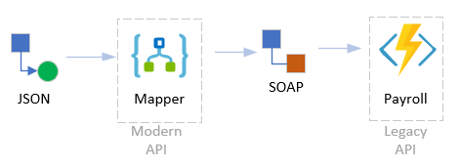
Legacy payroll pattern implemented – mapper

Slide 41
One solution cont.
3rd party provider managed API
Dynamics events into event-grid

Slide 42

One tech choice
Logic Apps
Ability to transform SOAP to other (REST)
Hundreds of connectors to connect to/from most sources
Serverless tech, very hands-off

Slide 43
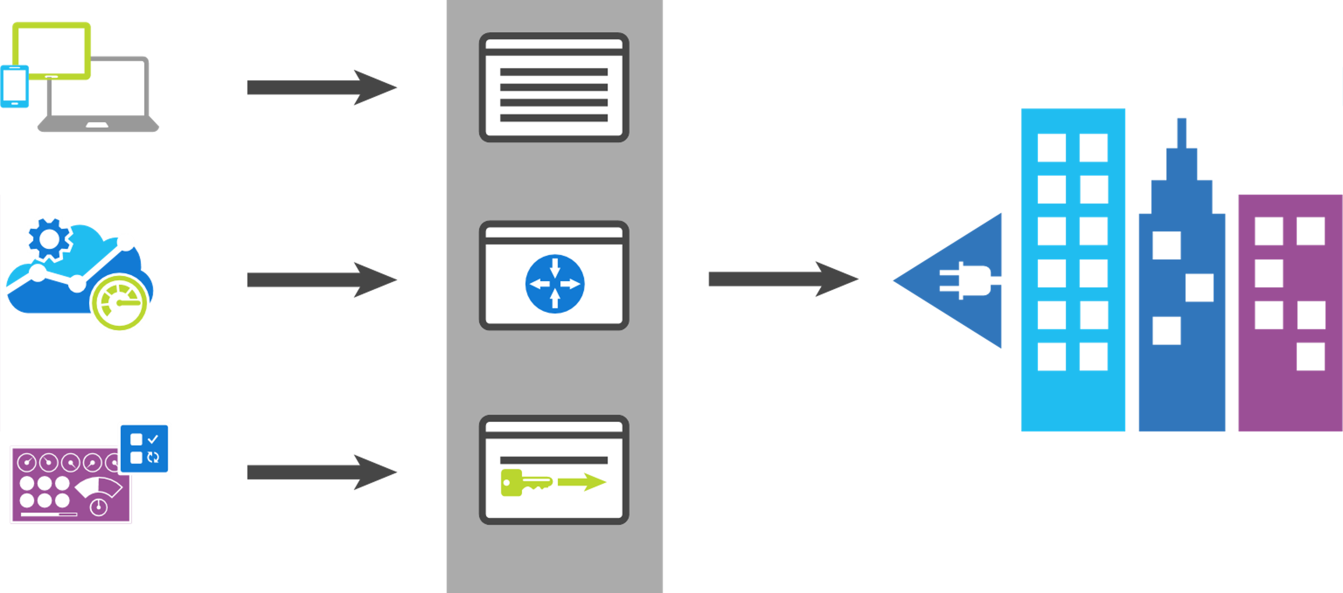
API Management
App developers
Developer portal
Direct to VPN
Apps
Gateway
Backend Services
Apps Publishers
Publisher portal
Notes:
Azure API Management fills all the roles of an API management platform, acting as an API Gateway, a Publisher Portal and a Developer Portal.
The API Gateway is the endpoint that accepts API calls and routes them to your backend services, making the necessary request and response transformations along the way. It’s responsible for enforcing security policies, usage quotas and rate limits, providing optimisations such as caching and for collecting and logging all the metadata on how the APIs are being used for reporting and analysis.
The Publisher Portal is the admin interface where you register and configure your APIs – defining or importing the schemas, packing APIs into products, setting up policies and managing users.
And the Developer Portal acts as the community site for your developers, where they can read API documentation, try out an API via the interactive console, create their account and subscribe to get API keys and access analytics on their own API usage.

Slide 44
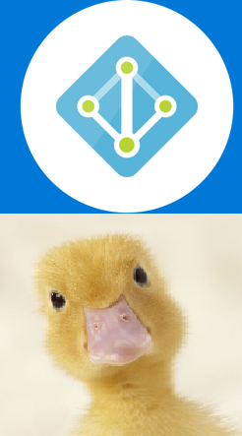
Security
Access control
Use Azure Active Directory
Customize Branding
PIM, conditional access etc.
Apply to any of the services

Slide 45
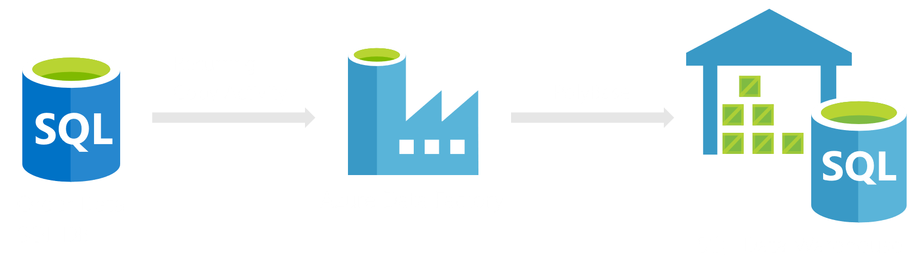
One tech choice
Data Warehouse

Slide 46
Questions?...

Slide 47
Your case study
3 core steps, which must be done in order:
Design an ‘integration asset register’
From the above register, construct the logical diagram of integration flow
From your logical diagram, construct your technical architecture diagram

Slide 48
Your integration asset register – 15 minutes
Use the template below (or something different!). Have a think about patterns to apply:

Slide 49
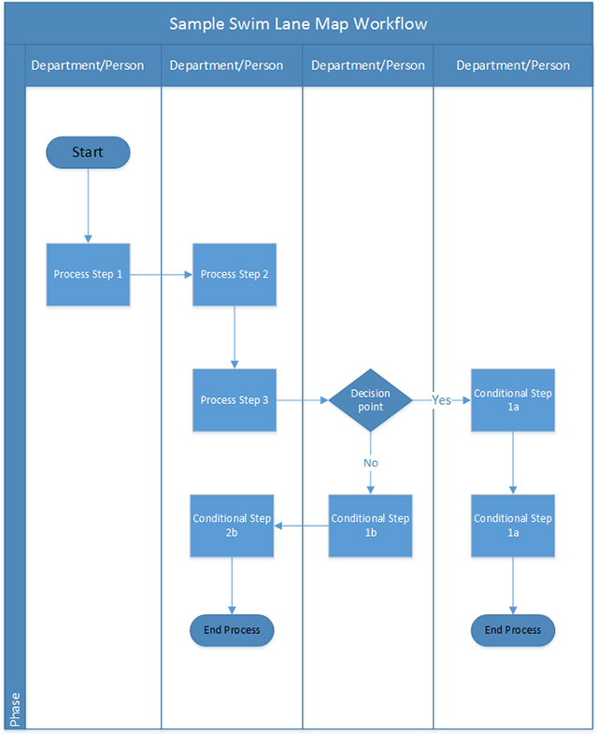
Your integration asset register cont.
Are you using one big biztalk scenario which does 20 different things with all sorts of conditional checks and logic?
Create a swimlane diagram documenting so:

Slide 50
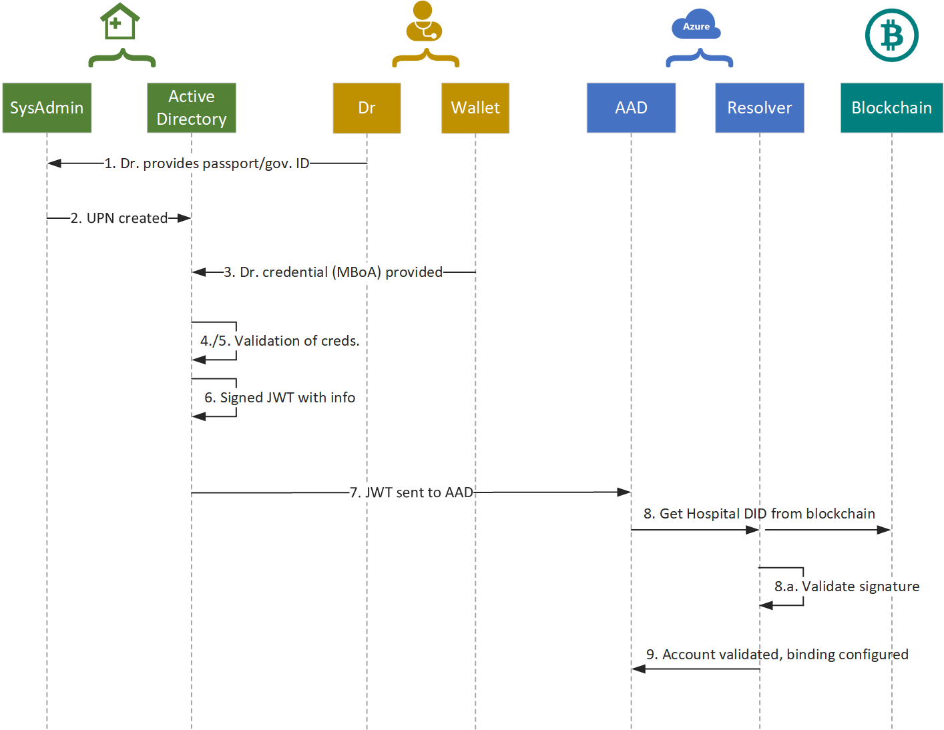
Your integration asset register cont.
Or use this?
Source: www.nlymbery.com.au

Slide 51
Your logical design – 60 minutes (optionalish)
Same as the case-study. It is NOT a technical diagram!

Slide 52
Your technical architecture
Now the fun stuff:

Slide 53
How can Microsoft help?
Blah
Azure specialists – <local STU resources here>
CSA – post-delivery architects providing support <Local CSU people>
Fasttrack – direct engineering support for qualified project
Next steps: reach out and give Microsoft a call!
<local specialist email/contact>
<Local specialist email/contact>

Slide 54
How can Insight help?
* Insight to discuss

Slide 55
Thank you!
Feedback: <email here>
Workshop Content:
https://aka.ms/workshop-integration-case-study

